Slide 1
REACT NATIVE
Lesson 6: Authentication with Firebase

Slide 2
Authentication
Firebase Authentication
React Native Elements
useAuthentication
HomeScreen
SignUpScreen
WelcomeScreen
SignInScreen

Slide 3
Authentication
npx create-expo-app@latest lesson6
npm run reset-project
npm install firebase @rneui/themed @rneui/base
Firebase JS SDK
Cross Platform React Native UI Toolkit (React Native Elements)
Delete index.tsx
Copy Resources

Slide 4

Firebase Authentication
https://firebase.google.com/

Slide 5
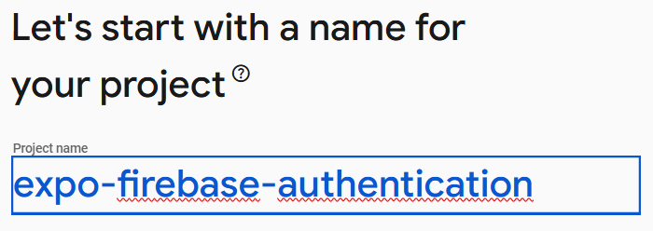
Setting up the cloud project on Firebase

Slide 6

Create Project

Slide 7
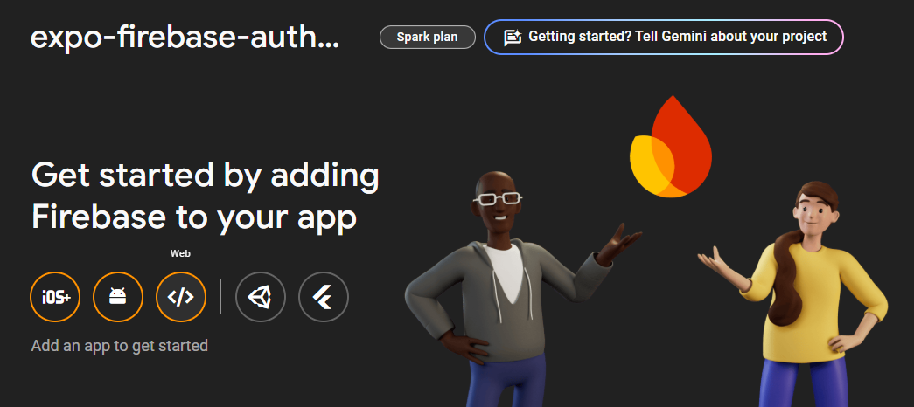
Web App

Slide 8
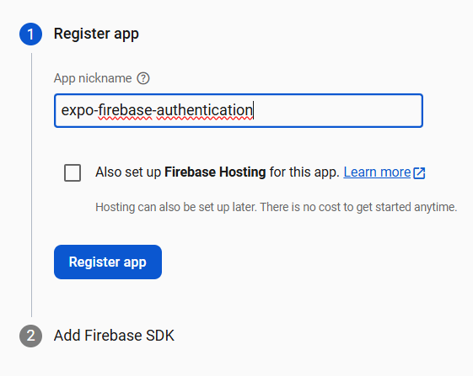
Add Firebase to your web app

Slide 9
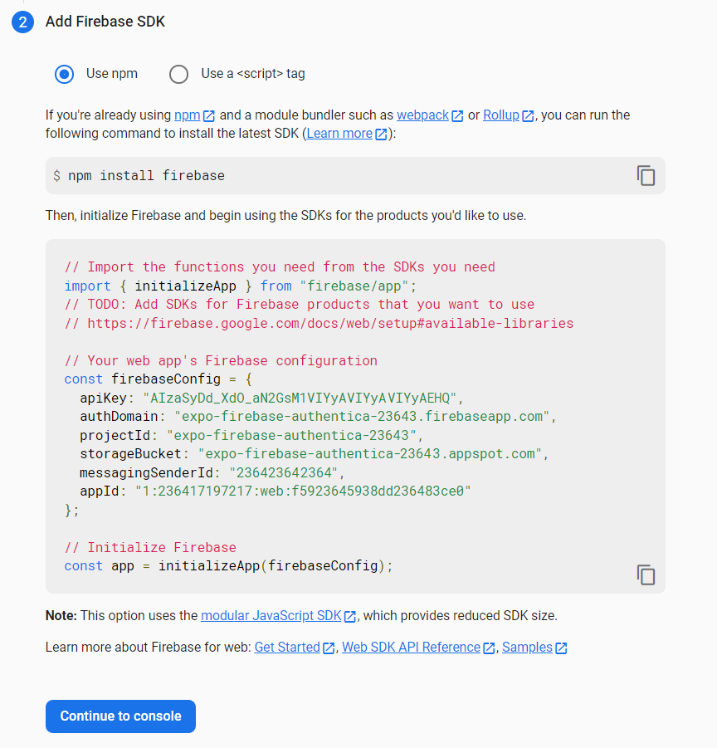
Initialize Firebase
You will receive instructions on the screen with your setup configuration, including your application keys.
Copy the JavaScript code to initialize Firebase in your React Native app

Slide 10
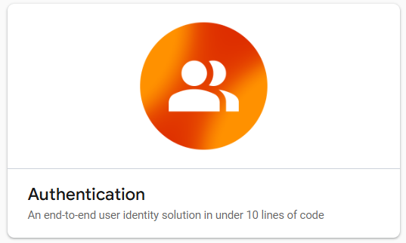
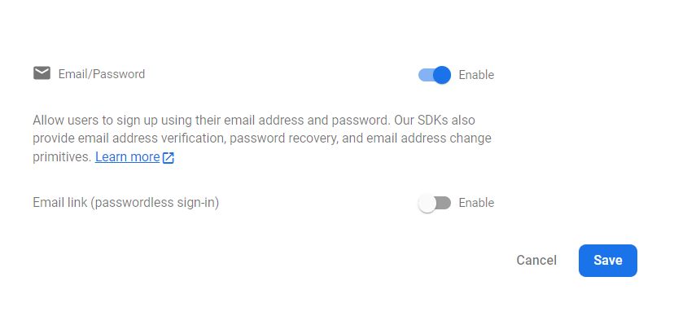
Add Authentication
The app is ready
Add the Firebase services you want, Authentication in our case

Slide 11
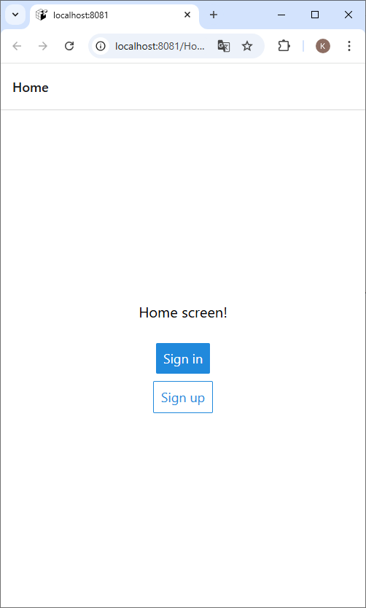
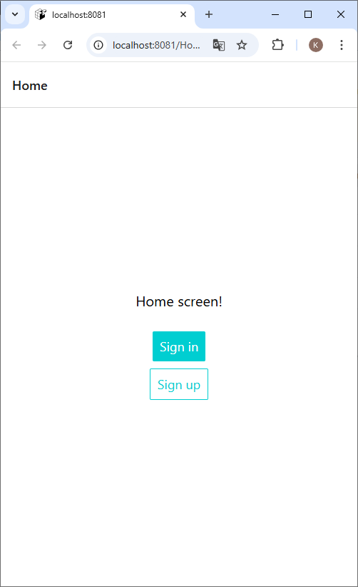
Start the project

Slide 12
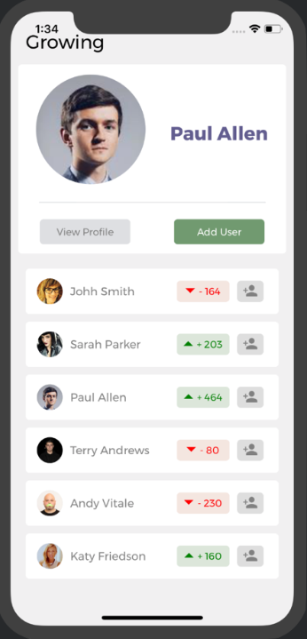
React Native Elements
Cross Platform React Native UI toolkit
Instead of styling every component, use the createTheme() function to create a theme style that overrides every component's internal or default styles.
The ThemeProvider will apply styles to any component wrapped inside it.
Experiment yourself and search for info on the internet.
https://reactnativeelements.com/docs

Slide 13
StackNavigation
import { createNativeStackNavigator } from '@react-navigation/native-stack';
const Stack = createNativeStackNavigator();
export default function App() {
return (
<ThemeProvider theme={theme}>
<Stack.Navigator initialRouteName="Home">
<Stack.Screen name="Welcome" component={WelcomeScreen} />
<Stack.Screen name="Home" component={HomeScreen} />
<Stack.Screen name="Sign In" component={SignInScreen} />
<Stack.Screen name="Sign Up" component={SignUpScreen} />
</Stack.Navigator>
</ThemeProvider>
);
}

Slide 14
getAuth()
const auth = getAuth();
getAuth() returns the auth instance within the provided app (in config/firebase.js)
You will need this auth instance in the method to create a user (sign up), to log in (sign in), to log out (sign out)

Slide 15
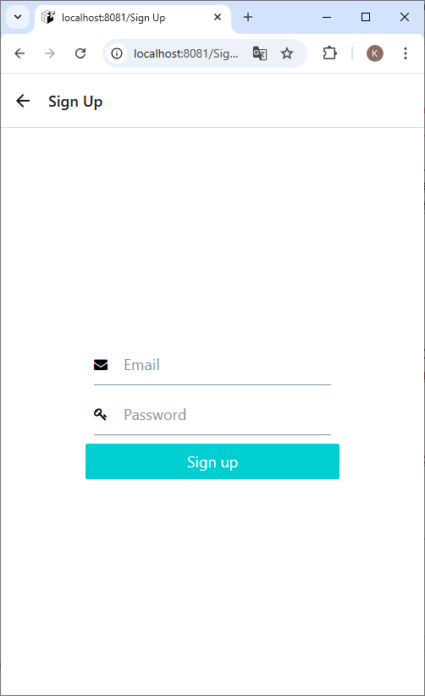
SignUpScreen
const auth = getAuth();
export default function SignUpScreen() {
const [value, setValue] = useState({
email: '',
password: '',
error: ''
});
return (
<View style={styles.container}>
{!!value.error && <Text style={styles.error}>{value.error}</Text>}
<Input ... /> <Input .../> <Button title="Sign up" buttonStyle={styles.control} />
</View>
);
}

Slide 16
useAuthentication
The useAuthentication hook will identify if a user is authenticated or not.
In case there’s someone logged in, the hook will return the user information.
onAuthStateChanged
Adds an observer for changes to the user's sign-in state.
Will be triggered every time the authorization state changes, such as when a user logs in or logs out.
unsubscribeFromAuthStatusChanged
You can call this function to stop listening. Won't be used.

Slide 17
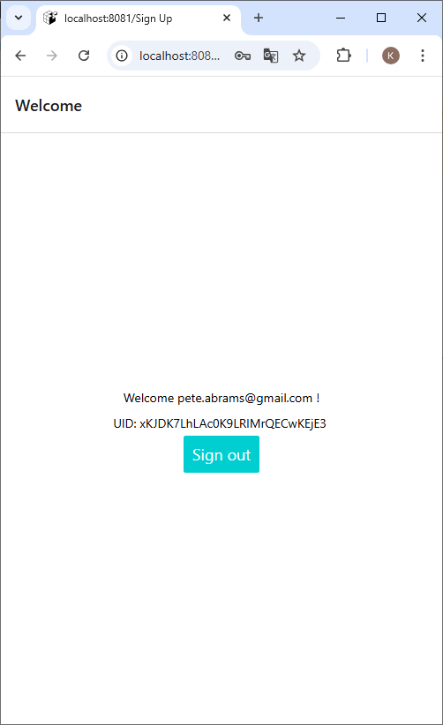
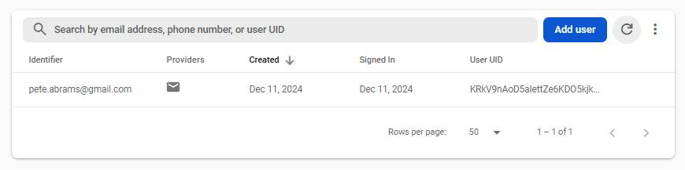
Welcome

Slide 18
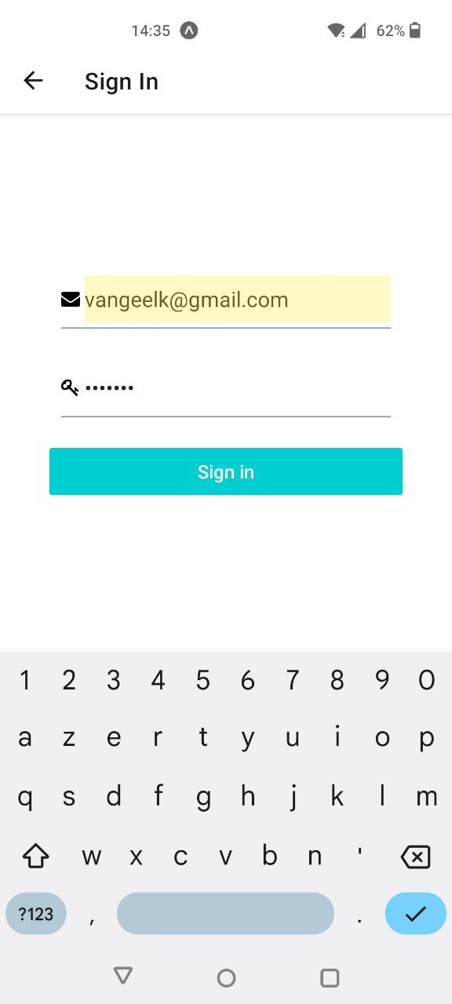
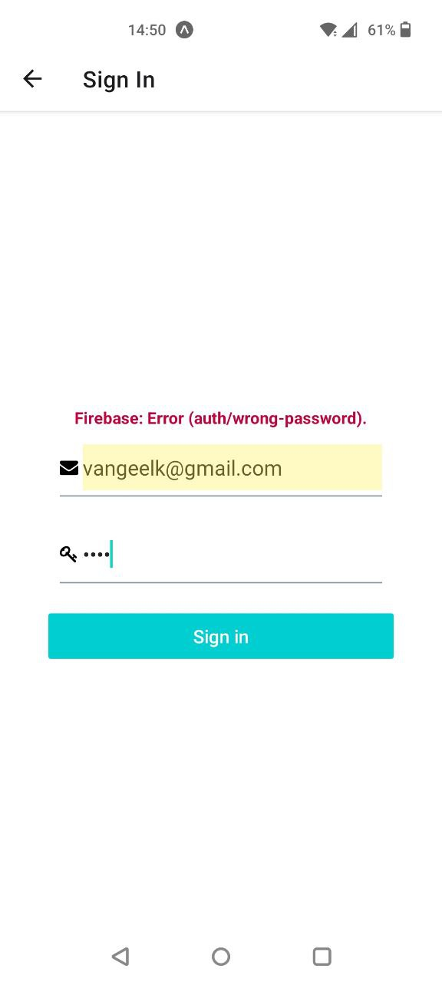
SignInScreen

